Slide 1


Machine Learning
Lecture 15: Introduction to Principal Component Analysis
Instructor: Dr. Shazia Saqib

Slide 2
Curse of Dimensionality
The curse of dimensionality in machine learning refers to various problems that arise when working with data in high-dimensional spaces (i.e., with many features or variables).
The curse of dimensionality is the set of problems that arise as data dimensionality increases, including data sparsity, ineffective distance metrics, high computation, and overfitting, all of which can hurt machine learning performance.
As the number of dimensions increases, the data becomes sparser, and many algorithms become less effective or computationally expensive.

Slide 3
Principal Component Analysis (PCA)
What is PCA?
Why do we need PCA?
A technique used to reduce dimensions while preserving essential data characteristics.
High-dimensional data is complex and computationally expensive.
Helps in visualization, computational efficiency, and noise reduction.
PCA finds the most important features and removes redundant information.

Slide 4
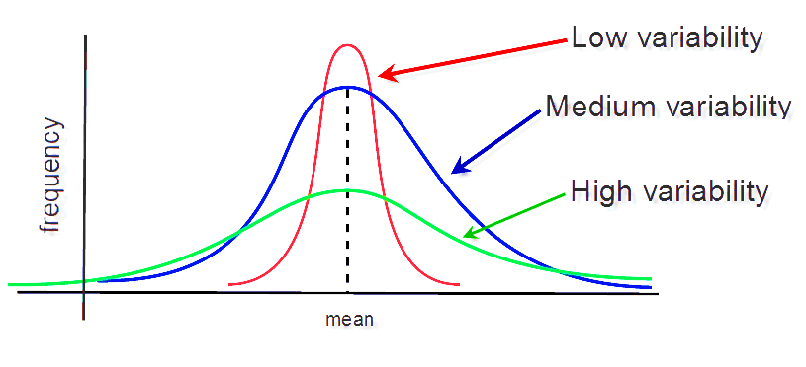
Understanding Data Variations
1
Data variation is the spread or dispersion in data.
2
Why is variation important?
High variation → Important information.
Low variation → Can be ignored.
3
PCA focuses on maximizing variance to capture key patterns.

Slide 5
What Happens in Higher Dimensions?
1
1D Data
2
2D Data
3
3D Data
Single numerical axis (e.g., price).
Data points are scattered across an x-y coordinate system. (e.g., Price vs. Area).
Data exists in three dimensions, but patterns may still lie on a 2D plane.

Slide 6



Reducing Dimensionality
High-dimensional data can be redundant. PCA helps by focusing on the most important aspects of your data.
Identifying major variations
Removing unimportant dimensions
Improving computational efficiency

Slide 7



Finding Principal Components
The first principal component (PC1)
Captures the maximum variation.
The second principal component (PC2)
Is perpendicular to PC1 and captures the second-most variation.
The process continues
For more dimensions.

Slide 8
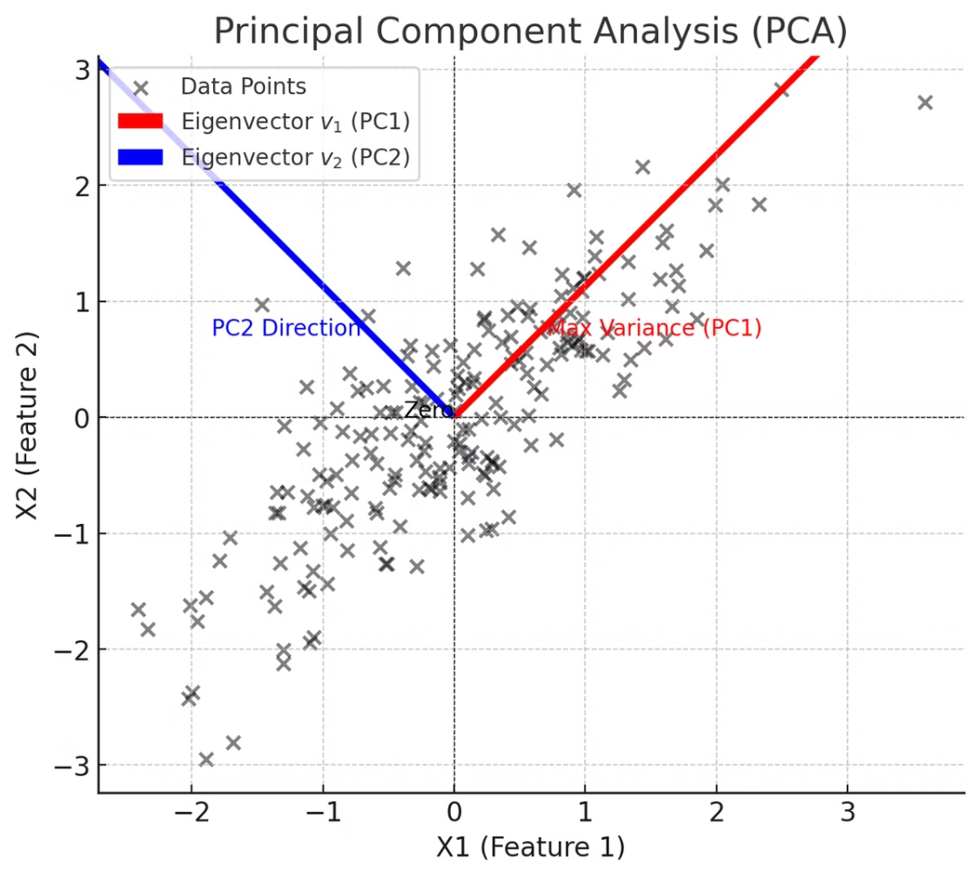
Example of Principal Components
House Prices vs. Square Footage Dataset
Imagine a dataset of house prices vs. square footage.
Data Spread Pattern
The spread of data is mostly along one axis.
PCA Application
PCA finds this direction and reduces dimensions accordingly.

Slide 9
Visual Representation of PCA
PCA redefines the coordinate system for better representation.
Before PCA
After PCA
Data is scattered in 2D or 3D.
Data is transformed to the principal component axis.

Slide 10
How are Principal Components Computed?
Uses Linear Algebra Concepts to extract meaningful components from complex data.
1
Eigenvectors & Eigenvalues
2
Singular Value Decomposition (SVD)
3
Direction Finding
Find the directions that capture the most variation
Mathematical foundations of PCA
Computational technique

Slide 11

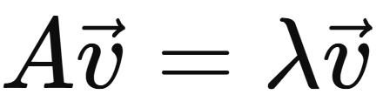
Eigenvector
Given a square matrix A, an eigenvector is a non-zero vector that does not change direction when a linear transformation is applied to it by A. Instead, it only gets stretched or compressed.
This relationship is described by the equation:
Where:
A is a square matrix,
is the eigenvector,
λ is the eigenvalue (a scalar), indicating how much the vector is scaled.

Slide 12
Intuitive Meaning behind Eigenvectors
Think of it like this:
Imagine a transformation like a rotation, scaling, or shearing.
Most vectors change both direction and length under this.
But eigenvectors only change in length—their direction remains the same.
The eigenvalue tells you how much the vector is stretched or squished.

Slide 13
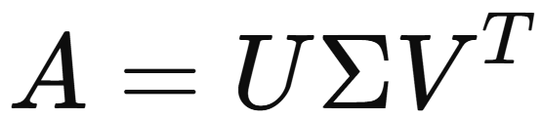
How are Principal Components Computed?
Using Singular Value Decomposition (SVD):
Where:
A: Original m×n data matrix
U: m×m matrix of left singular vectors (orthonormal columns)
Σ: m×n diagonal matrix of singular values (non-negative real numbers)
V^{T}: Transpose of n×nn \times nn×n matrix of right singular vectors (orthonormal rows)

Slide 14
Eigenvectors and Principal Components
1
Eigenvectors
Directions that define principal components.
2
Eigenvalues
Magnitude of variation along each eigenvector.
3
Importance
Larger eigenvalue → More important direction.
4
PCA
is computed using Singular Value Decomposition (SVD).

Slide 15
Singular Value Decomposition (SVD)
Mathematical method to extract principal components.
1
Compute covariance matrix
2
Find eigenvectors and eigenvalues
3
Rank components based on importance
Calculate how variables relate to each other
Identify key directions and their importance
Order by variance explained

Slide 16
Sorting Principal Components
1
Ranking By Sigma Values
2
Significance Hierarchy
3
Dimension Reduction
Larger sigma value → More significant component.
Lower sigma values can be ignored.
Components are sorted based on their singular values (sigma values).

Slide 17
Steps to Apply PCA
Step 1
Step 2
Standardize the dataset.
Compute the covariance matrix.
Step 3
Step 4
Perform Eigen decomposition (or SVD).
Select the top components.
Step 5
Transform the data.

Slide 18
PCA for Visualization
The Challenge
High-dimensional data cannot be plotted directly.
The Solution
PCA extracts PC1 and PC2 for a 2D visualization.
Example: 50D data with 4000 points → Reduced to 2D scatter plot.

Slide 19
Benefits of PCA
Removes redundant data.
Speeds up machine learning models.
Improves visualization by reducing dimensions.
Reduces noise by eliminating unimportant variations.

Slide 20
Limitations of PCA
1
Linear Relationships
2
Interpretability Issues
3
Scale Sensitivity
Data should be standardized
PCA assumes linear relationships, non-linear data may not be well represented.
Principal components are abstract

Slide 21
PCA vs. Traditional Feature Selection
Feature Selection
PCA
Removes features based on statistical tests
Transforms data into a new coordinate system
May discard important correlated features
Retains maximum variance
Works well for categorical data
Best for numerical data

Slide 22


Real-World Example of PCA
Face Recognition
PCA Application
A photo consists of millions of pixels (high dimensions).
PCA reduces dimensions while keeping key features for recognition.

Slide 23
Dimensionality Reduction in Action
Reduce dataset from 15 to 6 dimensions.
15
15
6
Original Features
Singular Values
Reduced Dimensions
Example: A dataset with 15 features.
Compute SVD → Extract 15 singular values.
Notice after 6 components, variation is negligible.

Slide 24

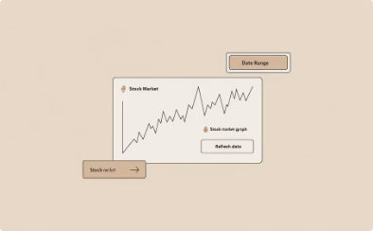
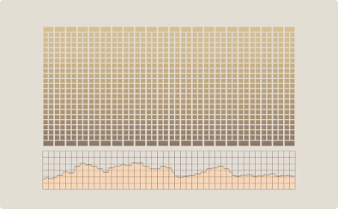

PCA in Machine Learning
Used in various fields:
Image Processing
Finance
Genetics
Speech Recognition
Facial recognition systems use PCA to extract key features while reducing image data complexity.
Stock market analysis uses PCA to identify patterns by reducing numerous variables to core components.
Gene expression analysis applies PCA to simplify complex genetic datasets while preserving biological variations.
Audio processing uses PCA to separate important sound components from background noise.

Slide 25
Conclusion
Dimension Reduction
Data Simplification
PCA helps reduce dimensions while retaining important variations.
It simplifies complex data, enhances visualization, and improves efficiency.
Variance Focus
Understanding variance is the key to PCA success.

